Slide 1




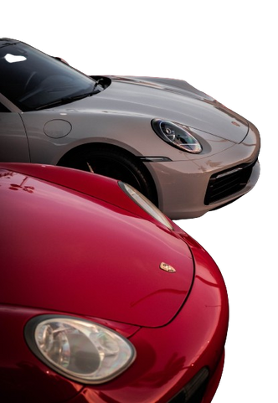
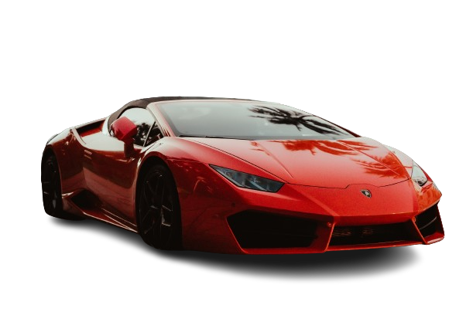
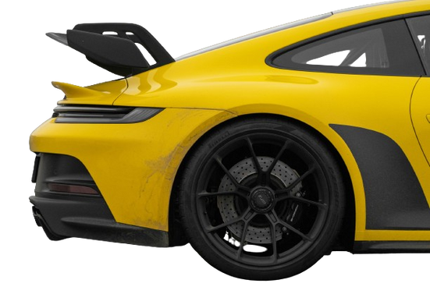
DP PROJECT
RACING IN IUT
Presented By: Tawfiq-E-Elahi
Student ID : 200042147

Slide 2
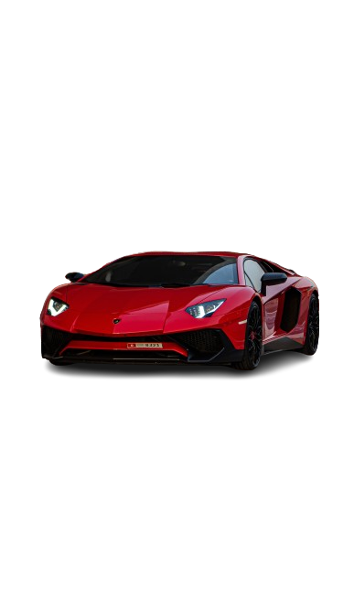
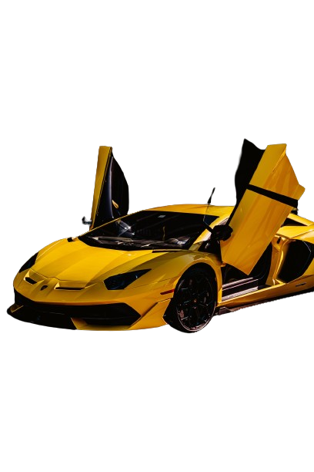
TABLE OF CONTENTS
01 - OBJECTIVE
02 - KEY FEATURES
03 - IMPLEMENTATION
04 - UML DIAGRAM
05 - CHALLENGES
06 - FLAWS

Slide 3
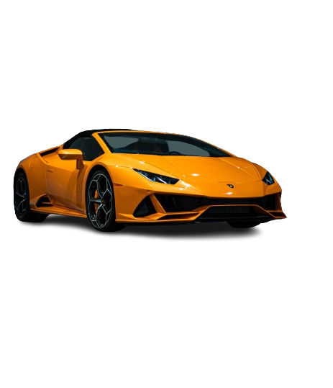
OBJECTIVES
Has to implement 5 different patterns: Strategy, Template, Singleton, Factory and Decorator.
Car class has engine and turbocharger behavior which can be updated in the run time.
Main class has an abstract factory of cars and a factory of track.
Only one instance of Player class can be created.
Extra functionally of NOS to the car object can be added at the run time.
Race method in the Race class will have a generalized steps of action for completing a race.

Slide 4
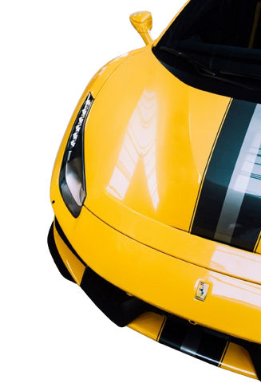
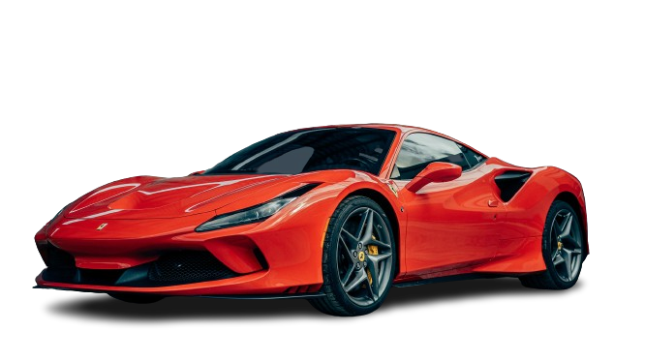
KEY FEATURES
1. User can choose from 2 car catagories using car factory from console.
2. Can choose car type from 2 types of car for each category.
3. Can choose track.
4. Can choose racing type.
5. Extra functionally NOS can be added at runtime if user wants.
6. Lap time generated in the console.
7. Race method in race class handles all steps from Car start, acceleration, apply NOS, Car stop etc.

Slide 5
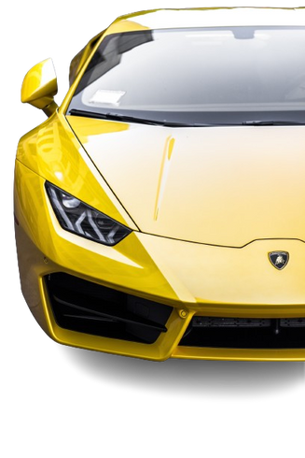
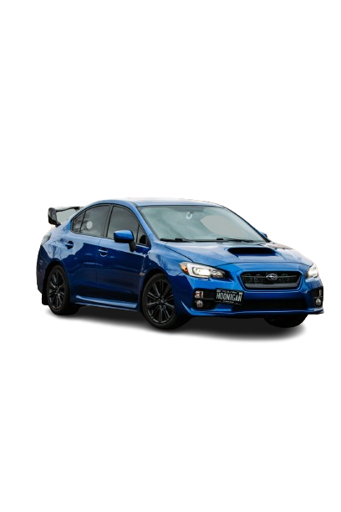
IMPLEMENTATION
Singleton Pattern: Player class implements this pattern as only one instance of player class can be created.
Template Pattern: Race class implements this pattern as race method performs a series of steps.
Strategy Pattern: EngineBehaviour, TurbochargerBehaviour implement this pattern.
Abstract Factory and Factory Pattern: CarFactory, CoupeCarFactory and RoadsterCarFactory implent it.
Decorator Pattern: NOS class implemts this pattern as it allows to add nos at runtime.

Slide 6
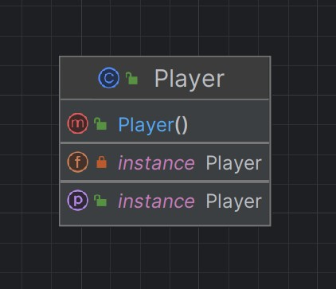
SINGLETON PATTERN

Slide 7
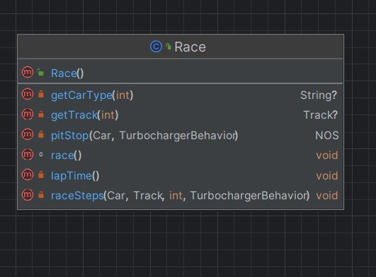
TEMPLATE PATTERN

Slide 8
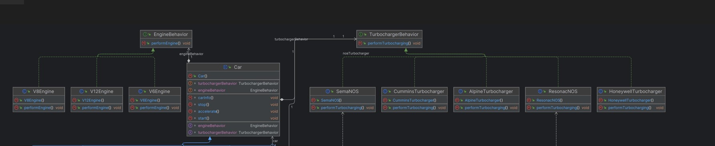
STRATEGY PATTERN

Slide 9
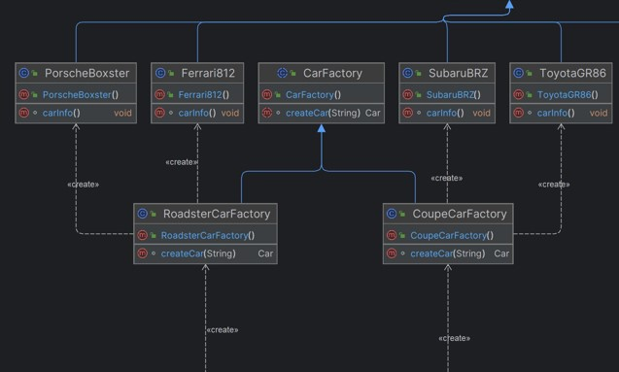
ABSTRACT FACTORY PATTERN

Slide 10
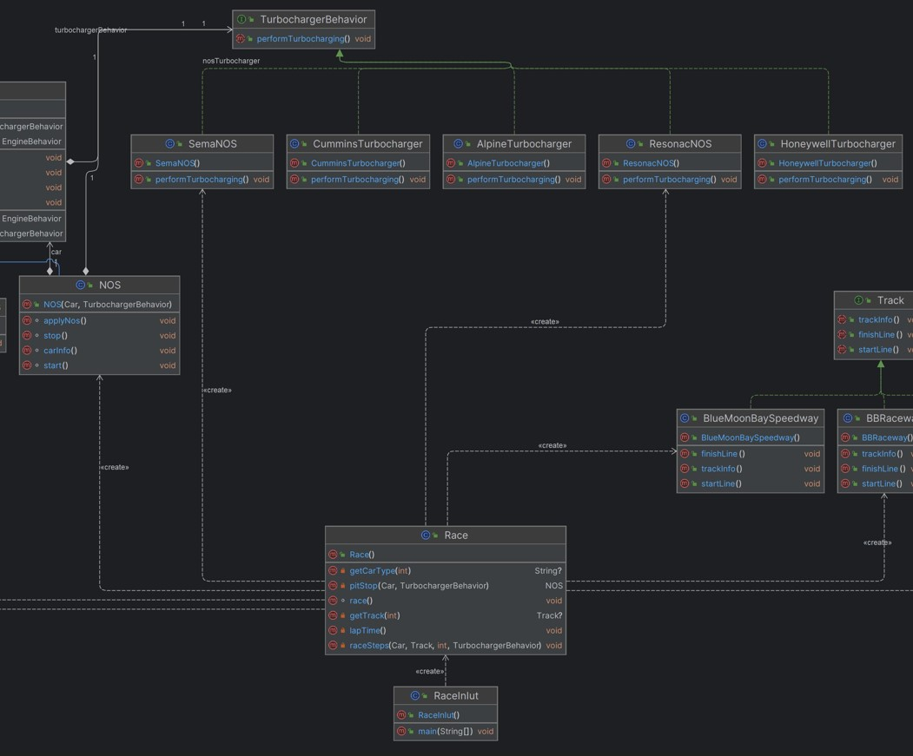
DECORATOR PATTERN

Slide 11
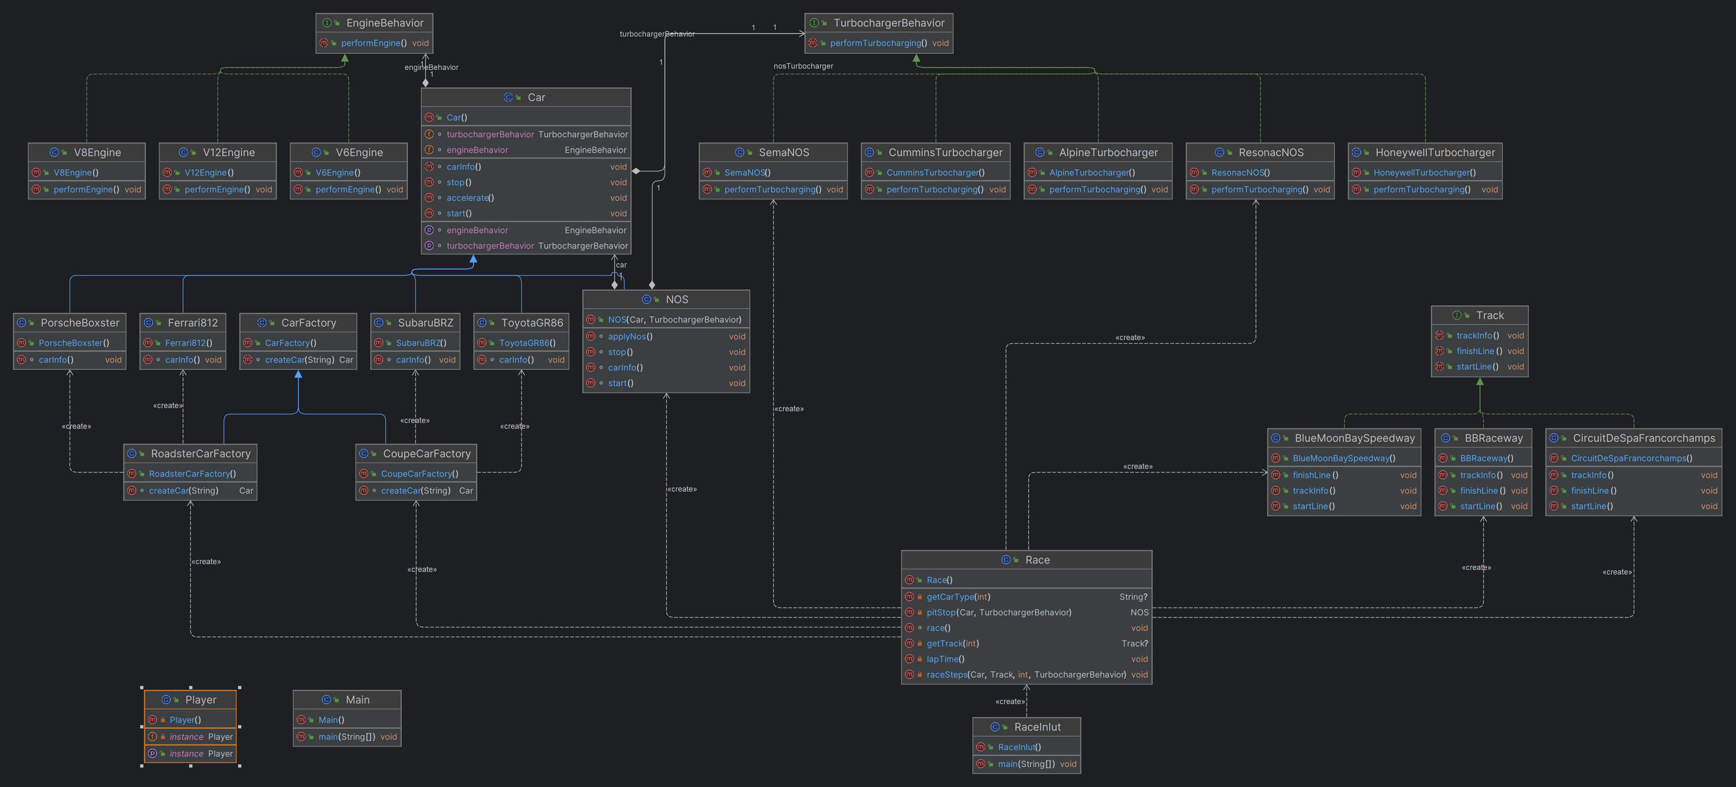
UML OF RACE IN IUT

Slide 12
CHALLANGES
Understanding the large class Race.
FLAWS
Strategy pattern has not been fully implemented. There is no user option to select engine or turbocharger in the runtime.
There is no factory for tracks.
No exception handling for user input.

Slide 13
THANK YOU
DEMONSTRATION.........

